Slide 1
Loan Default Prediction

Slide 2
Data Source
We downloaded the dataset from kaggle. The uploader sourced it from the IIIT Bangalore/ UpGrad institute.
“The Data was collected as part of Social Experiment to provide public inferences of how a person applying for Loan can get it completed in a minimal amount of time. Also, adhering to the facts as which type of customers fail to repay the installments or full loan and provide inference so that the person applying for loan does not falls into that category.” (Kaggle 2022)

Slide 3
Why this data is interesting
Our goal
We chose this data is because we are interesting in the financial industry
Each row in this data represents an individual client who applied for a loan and his/ her information.
The data has 122 columns, and is very detailed. There are columns such as what type of apartment they live in, whether their building has an elevator and many other minute details.
We will likely cut off many of those columns.
Our goal is to create a model that will predict whether a client will default or not.

Slide 4
What problem are we trying to solve
Why our problem is important
We are trying to minimize the risk of a client defaulting on a loan for a financial firm.
This problem is important because everytime a customer defaults, the bank loses money. So we are trying to predict who could default and prevent the problem or assist them ahead of time.
If a client is likely to repay the loan, then not approving the loan may lead to a loss to the firm
If a client is not likely to repay the loan, i.e. he/she is likely to default, then approving the loan will also lead to a financial loss for the company.
We must be able to accurately approve clients to ensure profit and reduce losses.

Slide 5
Basic Assumptions Held/ Hypothesis
We assume income, numbers of family members, and education would have the most significant impact to credit default.
The higher income a client has, the less likely for him/her to be labeled as risky
The more family members a client has, the more likely they will have difficulties paying their installments.
The higher education a client holds, the less likely they will default.

Slide 6
What analysis methods we used & Why
Since we are trying to predict whether a person will default or not and the outcome is categorical, we used:
Stepwise feature elimination to remove redundant columns
We also used our common sense to remove redundant columns.
Logistic regression with original predictors
Decision tree
Neural network
Logistic regression with principal components
We chose these models due to the nature of the categorical target variable, which is whether a client defaults or not.
We also used python to perform the data manipulation and preprocessing. We used R for the PCA and stepwise regression.

Slide 7
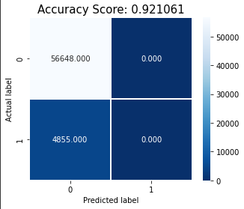
Key findings & insights
The most accurate models were the logistic regression with original predictors and with PCA . Both had an accuracy rate of 92.1%.
The neural network model had an accuracy rate of 91.88%.
The decision tree classifier had an accuracy rate of 84.49%.
However, the most insightful model was the stepwise feature elimination logistic regression model, as it had the least amount of predictors with a similar accuracy rate to the original regression. So it had less redundant information.

Slide 8
Key findings & insights
We found that if a client has completed higher education, they are much more likely to not default.
If a client is unemployed they are significantly less likely to default. However, If clients are state servants , they are significantly more likely to not default.
Recommendations to the firm:
Carefully select clients and let income type and education be some of the biggest factors to consider. For example if a client is unemployed, the firm can provide some resources ahead of time to assist the client to make payments. Or they could advertise more selectively to those who have completed higher education or are employed by the state to increase revenue and reduce risk.

Slide 9
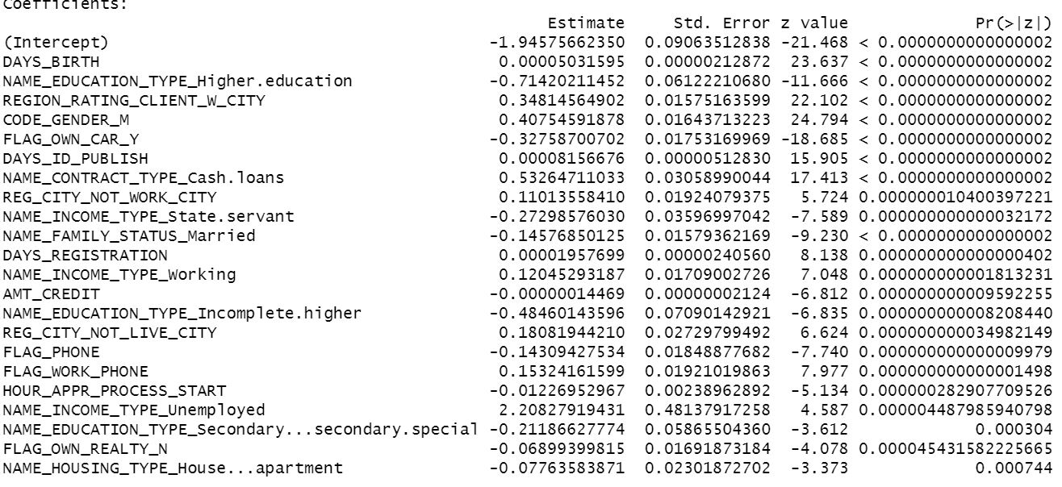
Coefficients after stepwise elimination

